Slide 1

From Awareness to Action: Understanding Renewable Energy & Climate Solutions

Slide 2

Climate Change
What Is Human-Made Climate Change?
Scientists have been observing global warming for several decades
The change is happening at an unprecedented speed, faster than any natural climate change in human history
Greenhouse gases like CO₂ and methane, among others, accumulate in the atmosphere,
trap heat and cause the planet to warm; what increases the frequency and intensity of extreme weather events
Human activity, especially the burning of fossil fuels, is the main cause
Critical tipping points are approaching, possibly leading to irreversible
damage to ecosystems and the loss of lives and biodiversity
grafic: © biodiversitystripes.info and LPI 2024, Living Planet Index database
Global Warming (above: blue to red)
and biodiversity loss (below: green to gray)
1970-2020
1970 2020

Slide 3
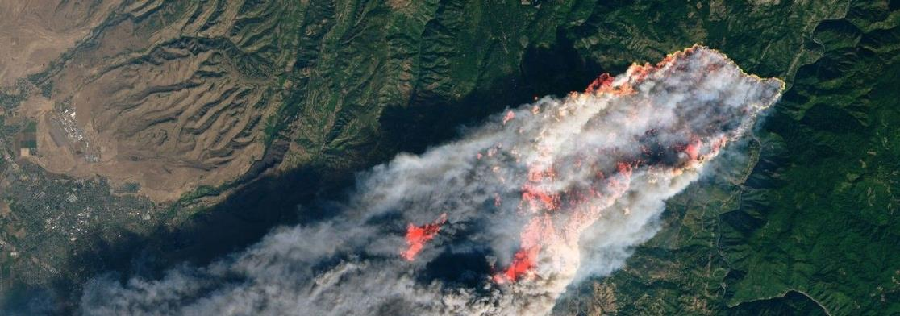
Climate Change
Observed Impacts
Heatwaves, storms, and droughts are becoming more frequent and severe, they can trigger secondary hazards like wildfires and floods
Sea levels are rising due to the melting of polar ice caps, threatening coastal regions worldwide
Rising temperatures are causing biodiversity loss on land and in water; ocean acidification is endangering marine ecosystems
Food and water security is declining, leading to increased poverty, malnutrition, diseases
Weather-related events displaced 23.1 million people annually between
2010 and 2019, making millions more vulnerable
to poverty
photo: © assets.science.nasa.gov

Slide 4
Climate Change
Do you already have experiences like these in your community?

Slide 5
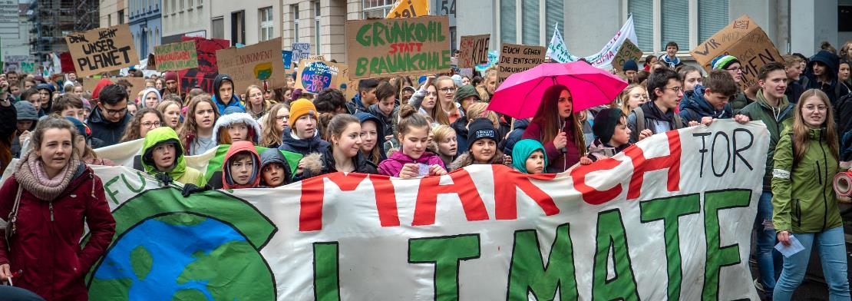
Climate Change
Conference of the Parties – COP
Every year, members of the United Nations Framework Convention on Climate Change (UNFCCC) gather for the UN Climate Change Conference (Conference of the Parties – COP), to deal with global warming
To avoid a climate catastrophe, scientists agree that global warming must stay below
2°C compared to pre-industrial levels
195 countries signed the Paris Agreement 2015 on keeping the rise of global temperature well below 2°C and pursuing efforts to limit the temperature increase even further to 1.5°C
By 2024, the global temperature has already risen
by 1.5°C
photo: © Mika Baumeister / unsplash

Slide 6
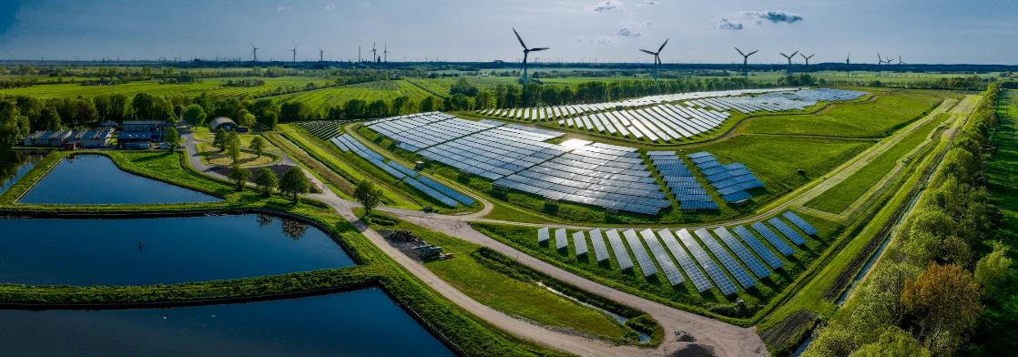
Renewable Energy
grafic: © Frederick Doerschem / istock
Why Renewable Energy?
It is an essential part of the global fight against climate change as extraction and usage of fossil resources are producing a large part of the global CO₂ emissions
Renewable Energy Types
Photovoltaic uses the sun light to generate energy either in big solar power plants
or decentralized e.g. on top of houses
Onshore wind farms in the country-side and offshore turbines at sea provide
wind energy
Hydropower uses flowing water through rivers or dams
to generate electricity

Slide 7

Renewable Energy
Renewable Energy Types
Geothermal and environmental energy is won from the heat below the surface or the air
Biomass energy is produced through burning organic material like wood or agricultural waste and can be turned into three types of bioenergy: heat, electricity, and transport fuels
Another process, co-generation, produces electricity while using leftover heat for heating homes or industries
Transport fuels, or biofuels, mostly come from energy crops, but newer biofuels made from waste and residues are also being developed
Nuclear energy is not future-proof because of the dangerous radioactive garbage, dependence on authoritarian states, expensive subventions, and potential abuse
Mining of uranium is not free of emissions

Slide 8

Renewable Energy
How Renewable Power Can Heat Homes and Fuel Cars
Sector coupling is important for making energy use more flexible. It connects sectors like electricity, heating and cooling, traffic, as well as industry and allows energy to be stored and used where it is needed
Electricity can power heat pumps (power-to-heat), produce green gases like hydrogen (power-to-gas), or make fuels (power-to-fuel). Green hydrogen is produced by splitting water into hydrogen and oxygen using
Green hydrogen is made by splitting water using electricity (electrolysis). It can be used in transport, heating, and power generation, but it is still costly to produce.
photo: © StockSeller / iStock

Slide 9
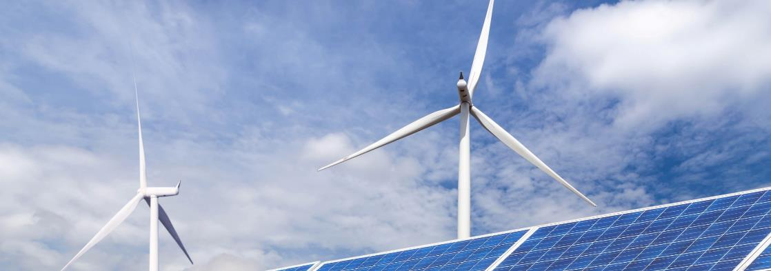
Renewable Energy
Reasons for Renewable Energy
Between 2010 and 2020, solar energy prices dropped by 85%, wind energy prices costs fell about 50%
Burning fossil fuels causes $8 billion a day in health + economic damage (COP 24 report)
Renewables could create up to 14 million jobs, and other energy-related industries could provide further 16 million. While about 5 million jobs in the fossil industry might be lost by 2030
Fossil power plants waste up to 50% of their energy as heat, renewable electricity is more efficient
Local renewable energy increases energy independence
and supply security
photo: © Soonthorn Wongsaita / shutterstock

Slide 10
Renewable Energy
What Can You Do?

Slide 11
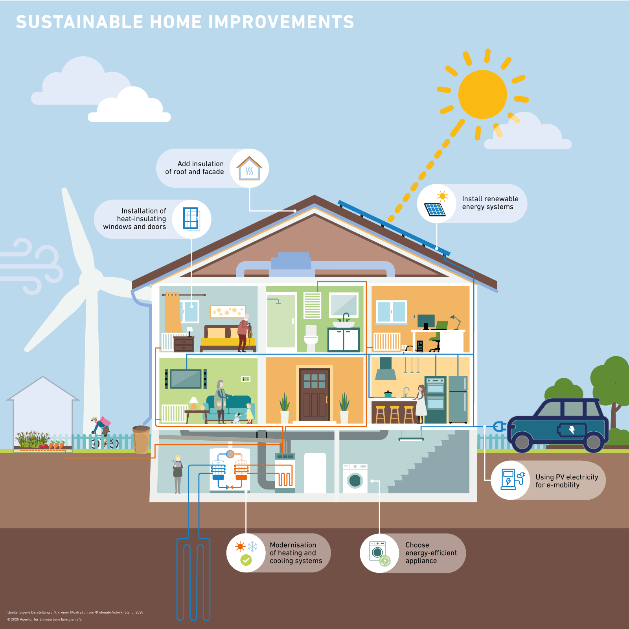
Energy Efficiency
Important and easy ways to reduce resources and costs in the consumption
of power and heating
graphic AEE and © elenab / istock

Slide 12
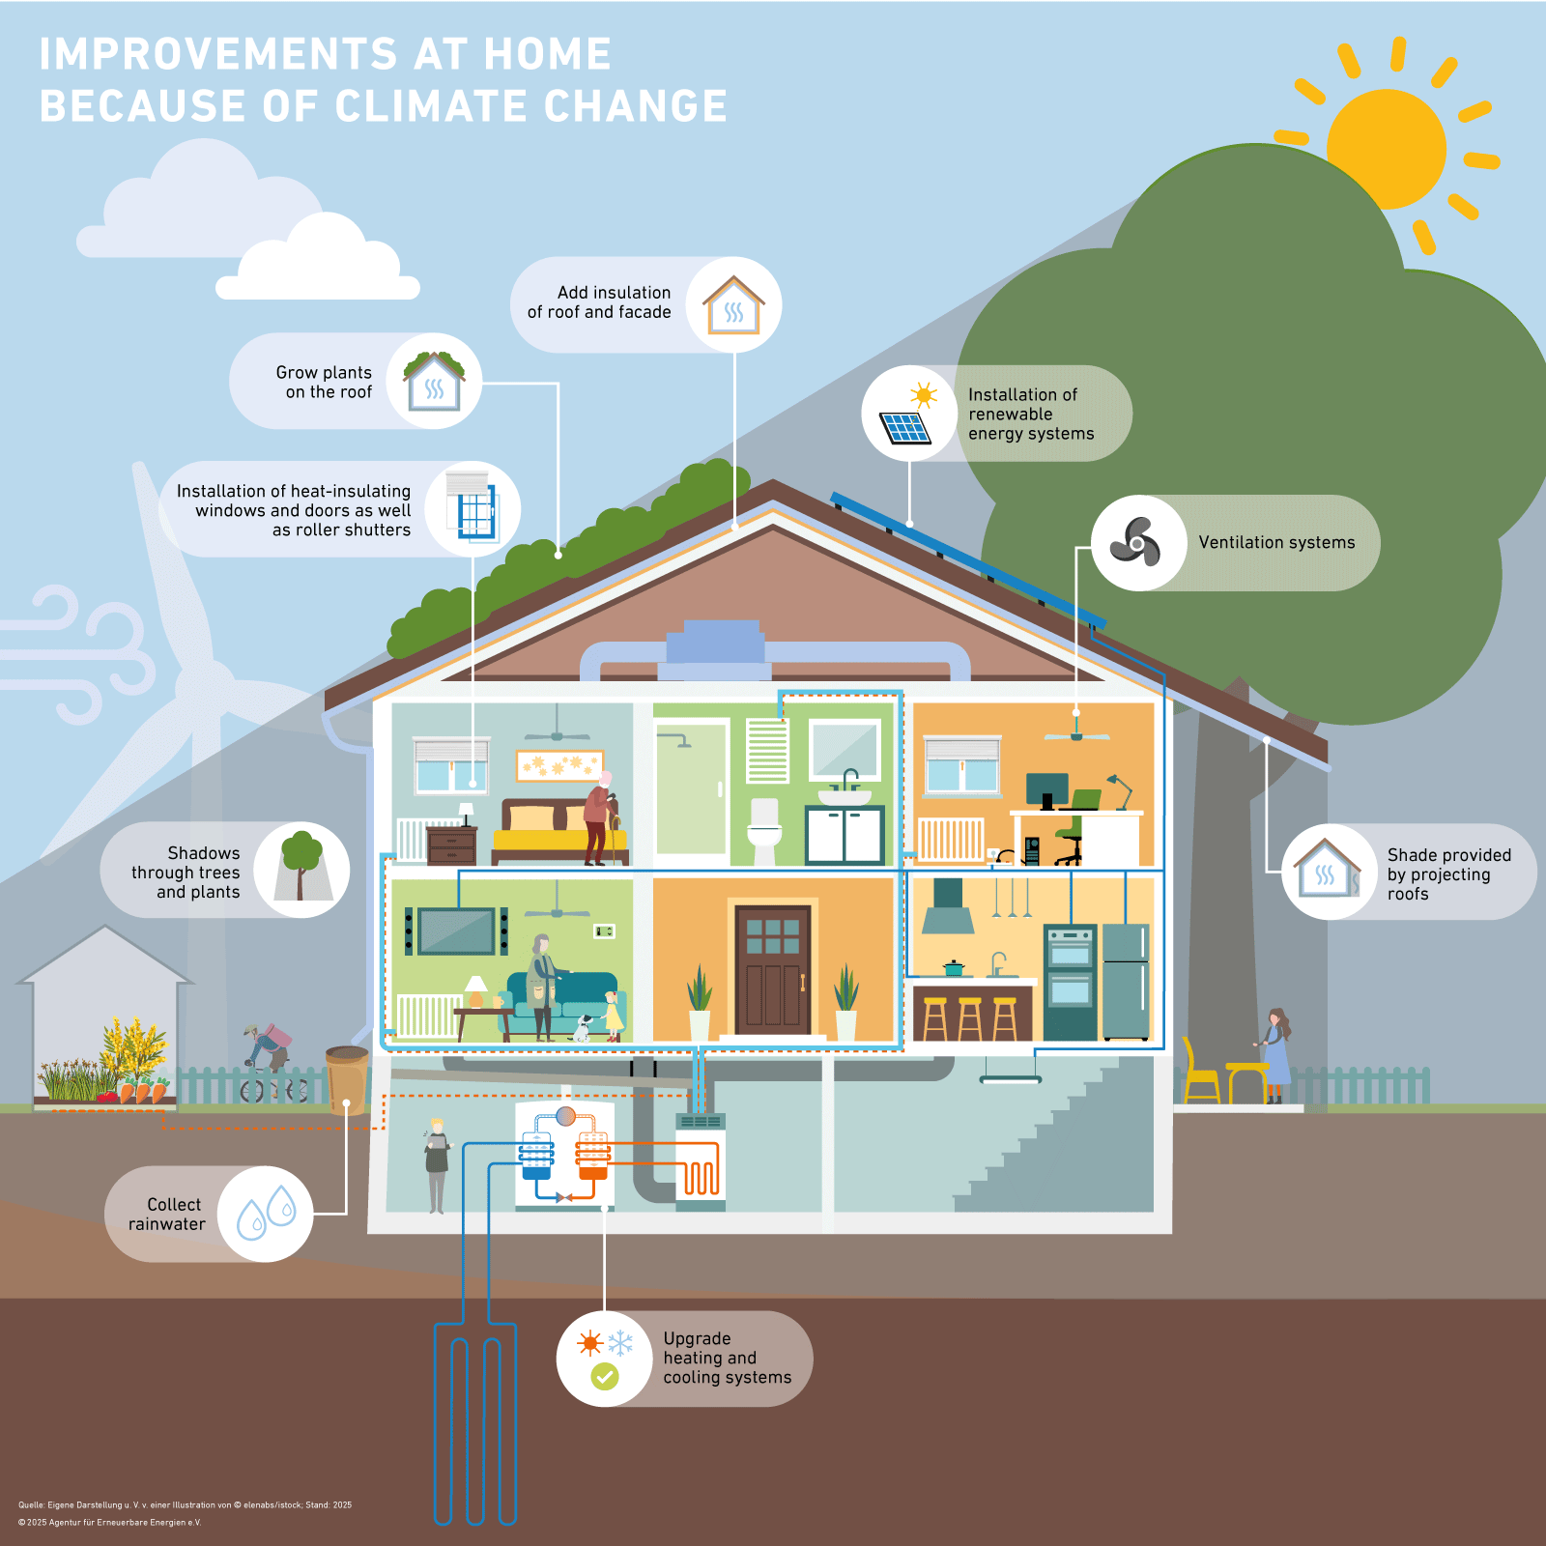
Energy Efficiency
Important and easy ways to reduce resources and costs in the consumption
of power and cooling
graphic AEE and © elenab / istock

Slide 13

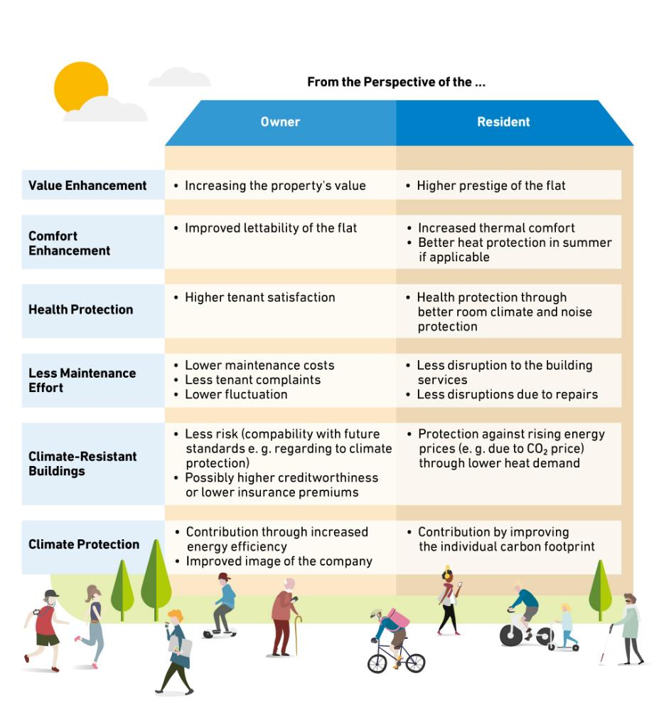
Energy-Efficient Refurbishment is:
graphic: © AEE

Slide 14
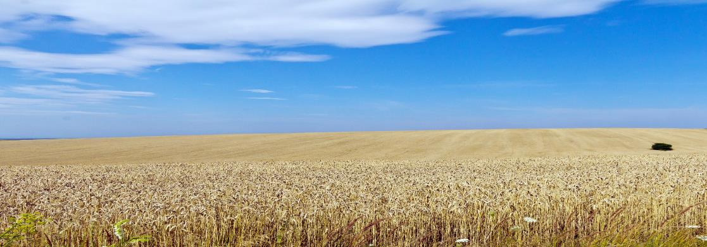
Local Perspective
Ukraine
The National Energy and Climate Plan (NECP) aims to cut greenhouse gas emissions by 35% by 2030 (compared to 1990), increase renewable energy to 27%, achieve climate neutrality by 2050, and phase out coal by 2035
The full-scale Russian invasion of Ukraine has destroyed critical energy infrastructure causing energy shortages, high costs, and problems for industries like steel
Post-war reconstruction will focus on renewable energy, as well as energy efficiency
Ukraine’s large agricultural sector offers great potentials to produce biomass
Solar energy is key to meet climate and renewable energy targets
photo: © Raimond Spekking / Wiki

Slide 15

Local Perspective
Chernivtsi
• The city has an approved Sustainable Energy and Climate Action Plan as a strategic
document that guides the municipality in its efforts to reduce energy consumption and
CO₂ emissions by 2030
• The region has a high solar insolation rate, which makes it ideal for implementing
projects using solar energy as a source of energy
• The city has already conducted the thermo-modernization of several old public
buildings, improving energy efficiency and reducing energy consumption, and plans to
continue this process
photo: © City of Chernivitsi

Slide 16
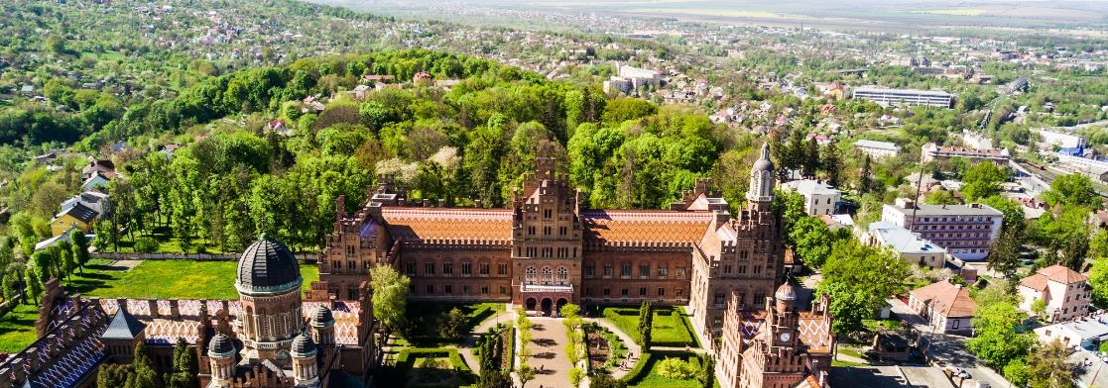
Local Perspective
Chernivtsi
• Since the full-scale Russian invasion of Ukraine, the destruction of critical energy
infrastructure has caused widespread energy outages in public and private buildings
• Chernivtsi focuses on ensuring a sustainable and autonomous energy supply as well
as rebuilding renewable energy infrastructure
• The geographical location of Chernivtsi, in particular its proximity to the eastern
borders of the EU, creates favorable conditions for development and European
integration
photo: © City of Chernivitsi
Notes:
Bitte noch Foto an Ausschnitt anpassen

Slide 17
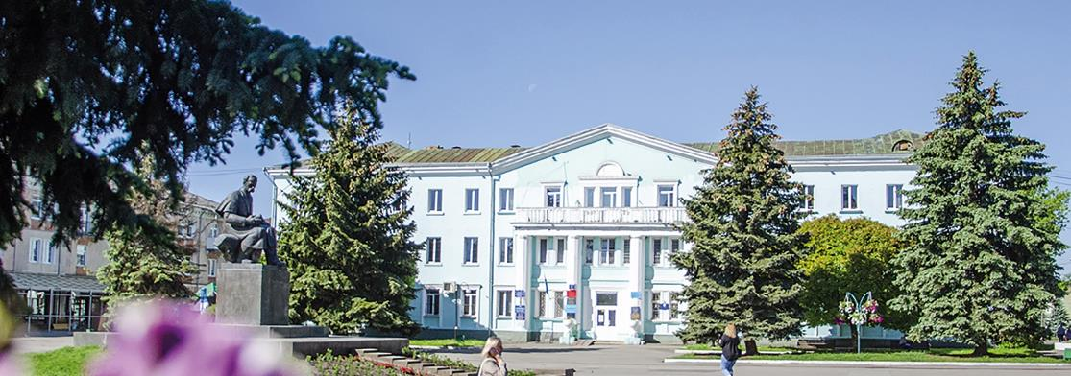
Local Perspective
Novovolynsk
Several projects such as: “Solar Panels at the Novo Business Support Centre”, “Hybrid Power Plant in the Maternity Ward”, or “Thermal Modernisation of Lyceum
No. 7” have already been successfully implemented
New project with GIZ: “Green Energy Complex: Eco-modernization of the Shakhtar Sports and Recreation Complex - Climate adaptation for sustainable development”
The project wants to transform the façade of the Shakhtar Sports and Recreation Complex (SRC), covering 120 m², into a green wall
An additional 427 m² of the surrounding area will be converted
into an urban garden, enhancing local biodiversity
and ecosystem services
photo: © Myroslava Vlasiuk

Slide 18
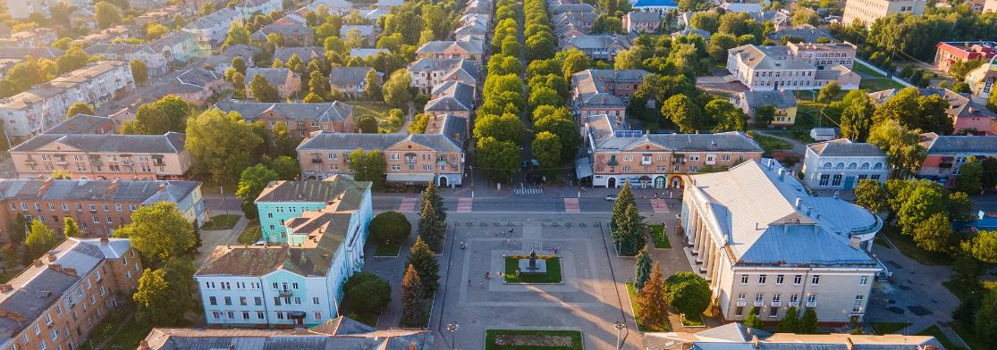
Local Perspective
Novovolynsk
Thermal modernization of 1,718 m² of the Shakhtar SRC will achieve annual energy savings of 73.7 MWh and financial savings of 386,600 UAH/year
A 20 kW solar power plant and energy efficiency measures, will lead to an annual reduction of 102 tonnes of CO₂ emissions
900 kW of solar power plants at the critical infrastructure facilities of Vodokanal are planned
A Sustainable Energy and Climate Action Plan has been developed
Among goals by 2030 are the reduction of CO₂ emissions,
and increase of the share of renewable
energy sources
photo: © Myroslava Vlasiuk

Slide 19
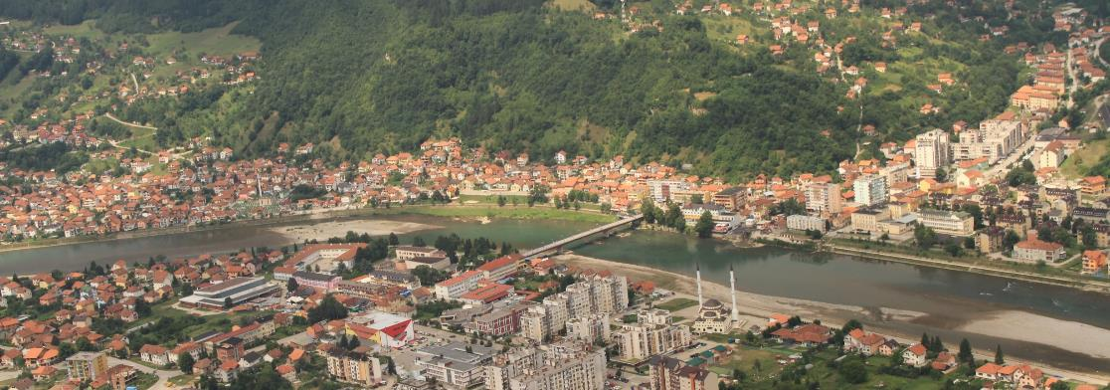
Local Perspective
Bosnia and Herzegovina
The National Energy and Climate Plan (NECP), is a chance to create a coherent and sustainable guideline for energy transition that aligns with the Paris Agreement and the Sofia Declaration of the Green Agenda for the Western Balkans
Challenges are rising temperatures, extreme weather events, drought and water scarcity, hydropower dependency, and environmental degradation
There is a remarkable potential in hydropower, biomass, wind, and photovoltaic
The transition of the coal mining sector with thousands of workers is an important part
of a sustainable and just transition
Plans to focus on energy efficiency in buildings, industry
transport, and the public sector
photo: © City of Goražde

Slide 20
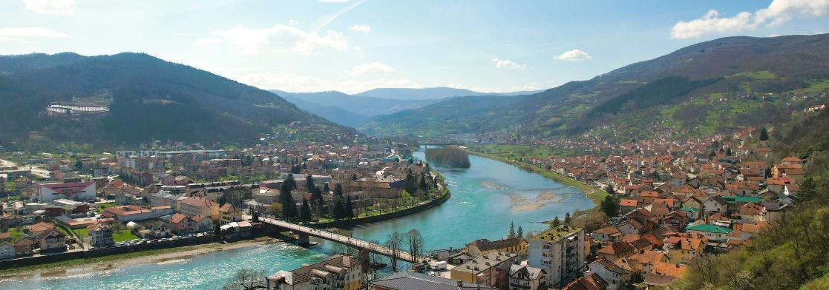
Local Perspective
Goražde
In 2010, the precipitation exceeded a 100-year record, causing floods in the Drina River Basin and Eastern Herzegovina; Goražde as well as other communities were inundated
Goražde supports biodiversity, e.g. via associations like “Eko Habitat” and focuses on energy efficiency in buildings, as well as using renewable energy sources, such as small hydropower and solar energy, e.g. for an improved waste management
  Most of the population heats with firewood as there is no gas supply
  The Drina River provides significant opportunities for sustainable development initiatives
  The goal is to balance economic development with environmental
  protection, including promoting
  green energy projects
photo: © Markus Spiske/pexels

Slide 21
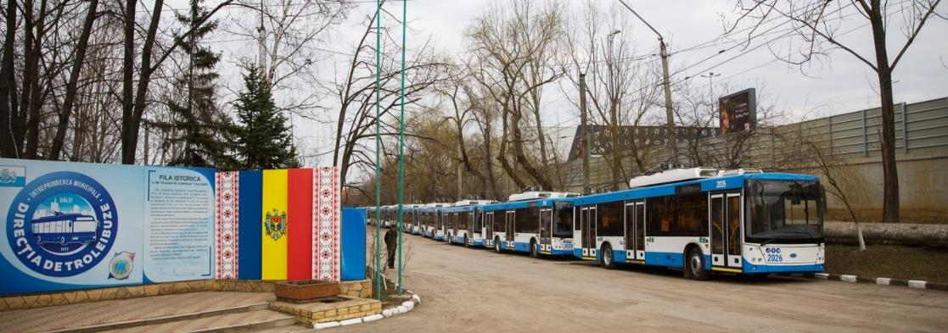
Local Perspective
Republic of Moldova
  Droughts are already a big problem in Moldova and climate change will make it worse
  Buildings account for more than 50% of the energy consumption and 45% of Moldova’s energy is consumed in households, whereas only 15% in industry. In 2023, only 6% of the energy came from renewables
  Since the beginning of the full-scale Russian invasion of Ukraine, gas prices have
  strongly increased, → independence from imports of fossil fuels is important for self-sufficiency
  As part of the Integrated Energy and Climate Plan, Moldova plans to increase
  renewable energy up to 30% in 2030
  Net zero emissions should be
  reached by 2050
photo: © Balti City Hall

Slide 22
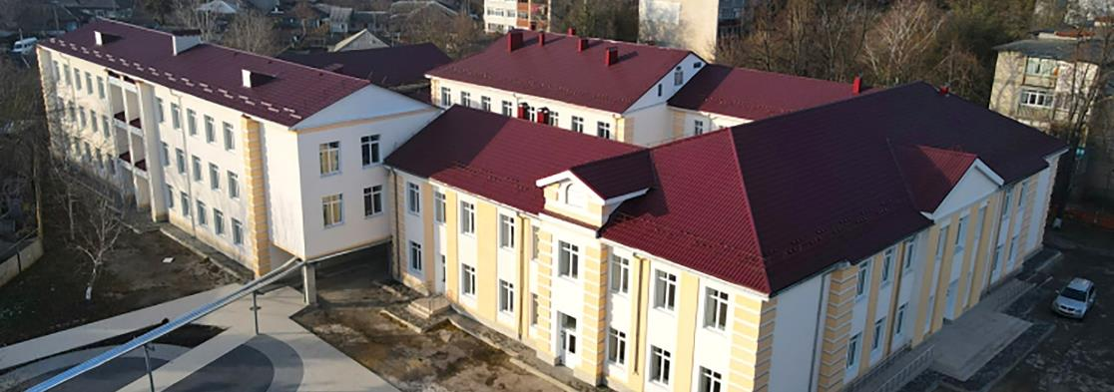
Local Perspective
Bălți
  400 public buildings consume 35% of the local energy requirement (10% of the national energy requirement)
  The city’s Green City Action Plan (GCAP) is a solid ground to improve seven sectors (land use, transport, water/wastewater, waste management, energy, buildings, and industry) with four main goals: reducing pollution and improving public health, scaling up clean and affordable energy, mainstreaming community- and knowledge-based development, and investing in resource efficiency and circular economy
  GCAP includes opportunities on gender and social inclusion and offers a space for
  feminist (foreign) politics and a holistic
  sustainable transformation
photo: © Balti City Hall

Slide 23
Sources
BMZ (2024): https://www.bmz.de/en/countries/moldova/core-area-climate-and-energy-just-transition-107492 (accessed: 28.01.2025).
Copernicus (2025): https://climate.copernicus.eu/copernicus-2024-first-year-exceed-15degc-above-pre-industrial-level (accessed: 28.01.2025).
European Environment Agency (2024): https://www.eea.europa.eu/en/newsroom/news/europe-is-not-prepared-for (accessed: 28.01.2025).
IPCC (2023): Climate Change 2023: Synthesis Report: Summary for Policymakers, IPCC, Geneva.
IRENA (2023): Renewables Readiness Assessment: Bosnia and Herzegovina, International Renewable Energy Agency, Abu Dhabi.
Primăria Municipiului Bălți (2021): Green City Action Plan for the City of Bălți, Primăria Municipiului Bălți, Bălți.
UN: https://www.un.org/en/climatechange/science/causes-effects-climate-change (accessed: 28.01.2025).
UN: https://www.un.org/en/climatechange/raising-ambition/renewable-energy (accessed: 28.01.2025).
UN: https://www.un.org/en/climatechange/what-is-renewable-energy (accessed: 28.01.2025).
UNDP Moldova (2023): https://www.undp.org/moldova/news/how-much-renewable-energy-there-moldova-and-how-much-could-it-be (accessed: 28.01.2025).
WHO (2018): COP24 Special Report: Health and Climate Change, WHO, Geneva.
IRENA (2021): https://www.irena.org//media/Files/IRENA/Agency/Statistics/statistical_profiles/europe/ukraine_
europe_re_sp.pdf (accessed: 28.01.2025).
EUETH (2024): https://usercontent.one/wp/www.ikem.de/wp-content/uploads/2024/11/241108-EUETH-NECP-summary.pdf (accessed: 28.01.2025).
IKI: https://www.international-climate-initiative.com/en/ukraine/ (accessed: 28.01.2025).

Slide 24
Press Contact
Renewable Energy Agency (AEE)
Anika Schwalbe
Tel: +49 30 200 535 52
a.schwalbe@unendlich-viel-energie.de

